Slide 1
Voice Recognition System
Guided By:
Prof. Jitendra Kumar
Presented By:
Mr. Shriraj Mahadev Gaikwad PRN: 230950125065 Mr. Prayash Raj Kushwaha PRN: 230950125046 Mr. Rishap Kumar PRN: 230950125052 Mr. Amit PRN: 230950125008

Slide 2
Contents
Introduction
Objective & Motivation
Problem Statement
Requirements
Algorithms
Overview of complete process
Result Analysis
Applications
Conclusion
References

Slide 3
Introduction
Explored machine learning techniques to develop a robust Voice Recognition System.
The project's core objective is to create a model proficient in accurately identifying and processing spoken words and phrases in real-time.
Notable features include real-time processing capabilities for swift responses, accurate recognition of diverse voice commands, and adaptability across various platforms.
The system's potential impact extends to revolutionizing user experiences by offering enhanced accessibility and contributing to the evolution of natural human-computer interaction.

Slide 4
Objective & Motivation
Objective:
Utilize machine learning techniques to create a sophisticated voice recognition model and achieve high accuracy in identifying and processing spoken words and phrases in real-time.
Enable seamless integration of the voice recognition system with diverse applications and devices, revolutionizing user experiences by enhancing accessibility and contributing to the evolution of natural human-computer interaction through voice-controlled technology.
Motivation:
Addressing the growing demand for hands-free and voice-controlled applications. Enhancing accessibility features in devices for users with mobility impairments. Enabling natural and intuitive interaction with technology through voice commands.

Slide 5
Problem Statement
Designing an efficient Voice Recognition System that accurately identifies and processes spoken words and phrases in real-time, addressing challenges such as variations in pronunciation, accents, and background noise. The goal is to optimize the model for low-latency response in real-time scenarios and enhance its adaptability across different platforms

Slide 6
Requirements
Hardware Specifications:
Machine: Desktop/Laptop
Operating system: Windows 10 or above, openSuse Leap15.2
Processors: Intel core i5
Memory: 8 GB RAM or above
Hard Disk (SSD): 250 GB or more
Video Card (optional): Intel Integrated Graphics (suggested–4GB graphics card - NVIDIA)
Network: Ethernet / Wi-Fi with 25 Mbps Speed Connection (UL/DL)

Slide 7
Requirements
Software Requirements:
Language: Python 3.11.5 or above (stable build)
Platform: Linux Latest stable build
Notebooks: Jupyter and Google Colab
Libraries: Pandas, Numpy, Matplotlib, Seaborn, Keras, Tensorflow, Scikit-Learn, Gradio, and Whisper

Slide 8
Algorithms
Algorithms used for prediction:
Convolutional Neural Networks (CNNs)
Recurrent Neural Networks (RNNs)
Libraries used for prediction
TensorFlow
Keras

Slide 9
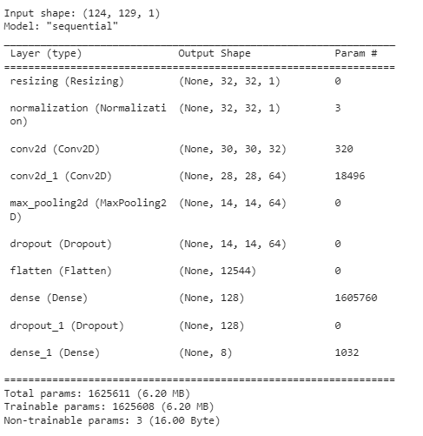
CNN Model Architecture

Slide 10
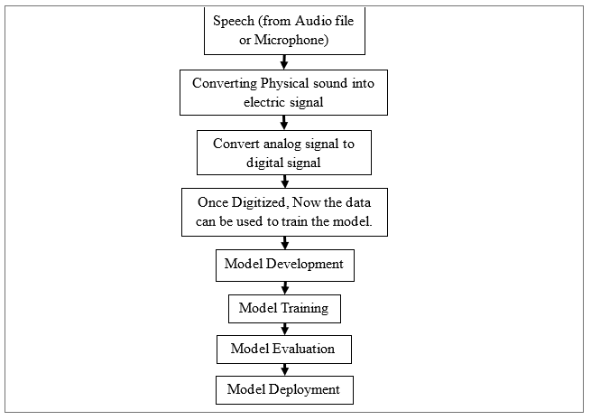
Overview of Complete Process

Slide 11
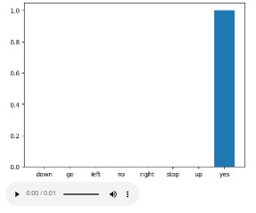
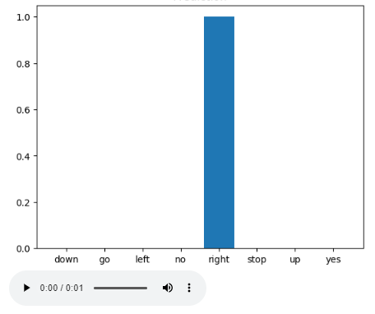
Result Analysis
This graph shows the verify the model's prediction output using an input audio file of someone saying “Yes"
This graph shows the verify the model's prediction output using an input audio file of someone saying “Right"

Slide 12
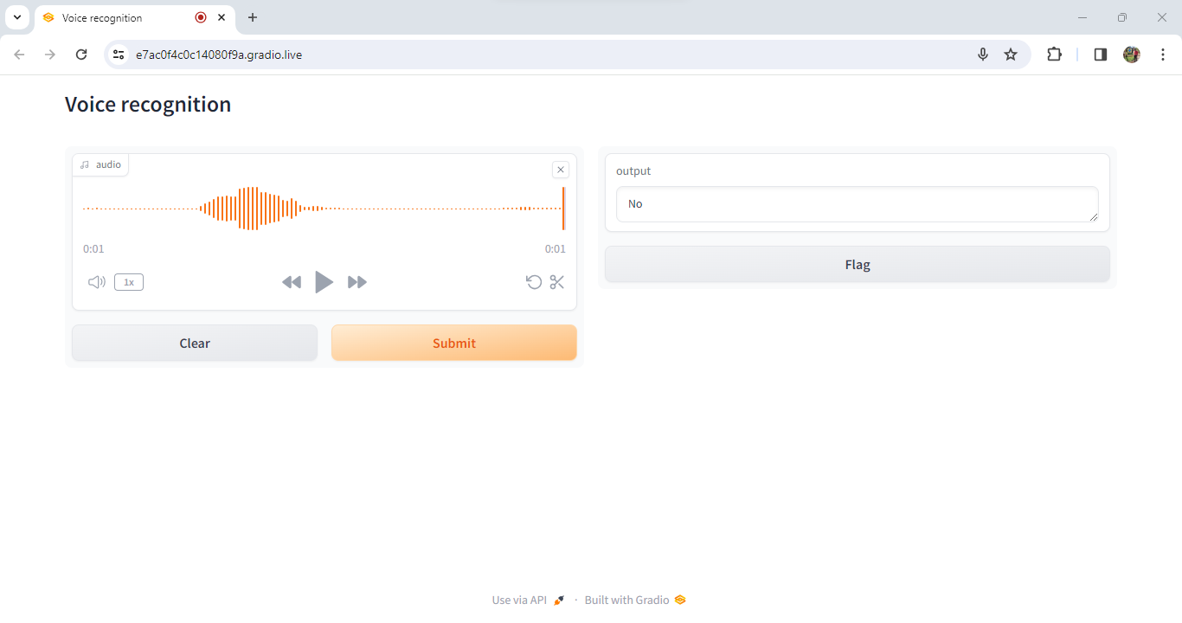
Gradio Interface

Slide 13
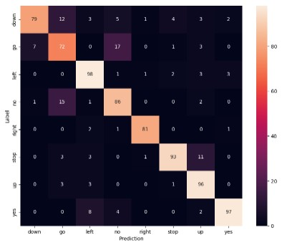
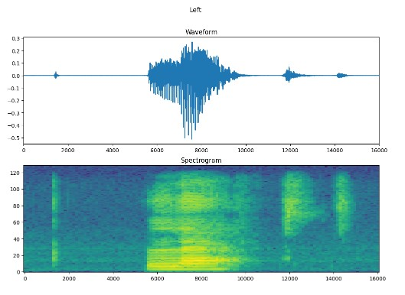
Result Analysis
Using a confusion matrix to check how well the model did classifying each of the commands in the test set:
Plotting the example's waveform over time and the corresponding spectrogram (frequencies over time):

Slide 14
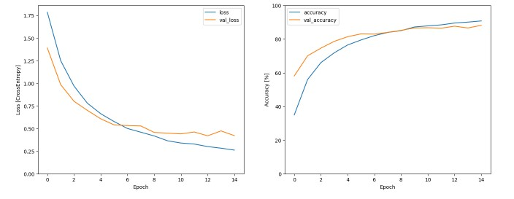
Result Analysis
Plotting the training and validation loss curves to check how our model has improved during training

Slide 15
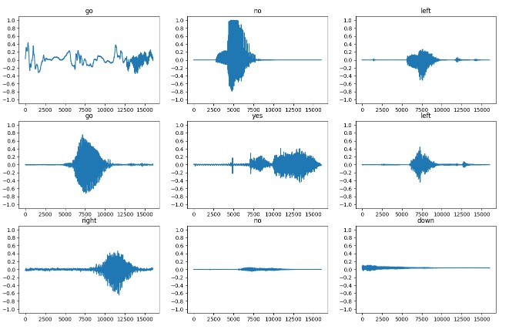
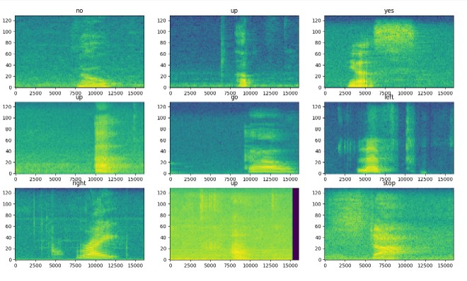
Feature Importance
Examine the audio waveforms and spectrograms for different examples of the dataset

Slide 16
Result Analysis
Check the training progress by observing how the training loss and accuracy change over epochs.
Examine changes in training and validation loss over epochs, aiming for a decline in both.
If early stopping is implemented, check its impact on preventing overfitting by terminating training at an optimal point.
Assess the confusion matrix to understand the model's predictions across different classes.
Visualize sample spectrograms, along with their predicted and actual labels, to gain insights into specific instances.

Slide 17
Applications
Voice Assistants: Integration with virtual assistants like Siri, Google Assistant, or Alexa for natural language understanding and response.
Speech-to-Text Systems: Converting spoken words into written text for applications such as transcription services, voice notes, and closed captioning.
Voice Commands in Smart Devices: Enabling hands-free control of smart home devices, TVs, and other appliances using voice commands.
Accessibility Features: Enhancing accessibility for individuals with disabilities by providing voice-controlled interfaces for computers, smartphones, and applications.

Slide 18
Conclusion
Successfully implemented a robust Voice Recognition System using advanced machine learning techniques, focusing on real-time identification and processing of spoken words and phrases.
Achieved notable features, including real-time processing capabilities, accurate recognition of diverse voice commands, and adaptability across various platforms, contributing to enhanced user experiences and accessibility.
The project's potential impact extends beyond conventional applications, revolutionizing human-computer interaction and paving the way for advancements in virtual assistants, smart devices, and customer service automation.

Slide 19
References
Dataset:
http://storage.googleapis.com/download.tensorflow.org/data/mini_speech_commands.zip
Reference for Machine Learning Algorithms:
TensorFlow Documentation
Online Courses
Research Papers
GitHub Repositories
ChatGPT

Slide 20
Thank You

